Slide 1
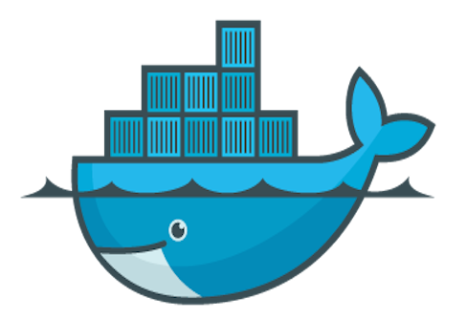
Package your application with Docker
Craftsmanship Community
Wroclaw, 27.04.2018
Krzysztof Sobkowiak

Slide 2
Disclaimer
Views in this presentation are my personal views and do not necessarily reflect the views of Capgemini.

Slide 3
Introduction

Slide 4
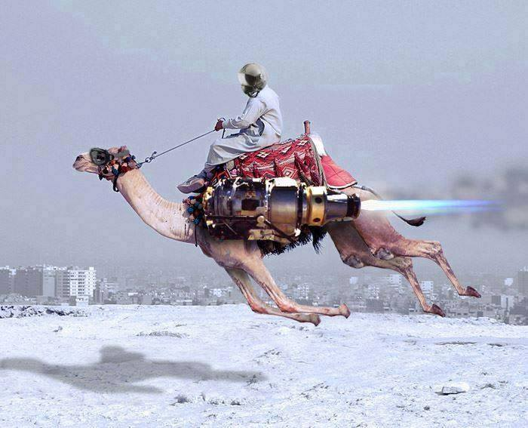

Slide 5
Creating business value through software is about speed, safety, iteration, and continuous improvement

Slide 6
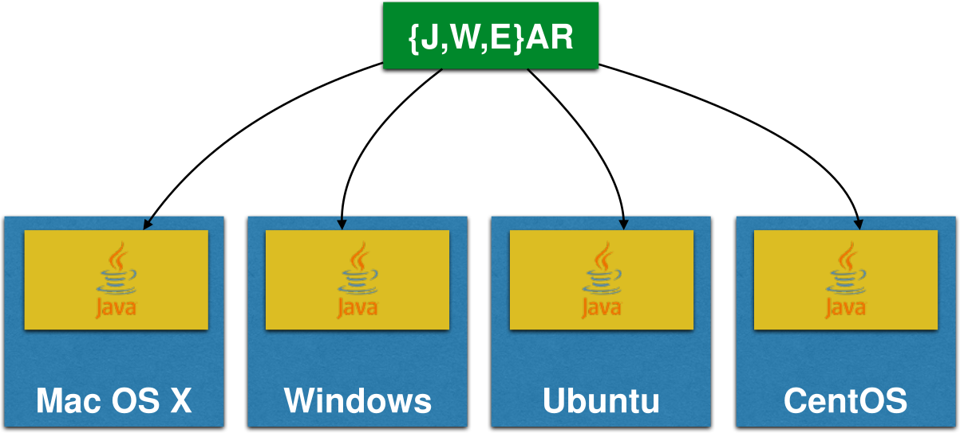
WORA - Write Once Run Anywhere

Slide 7
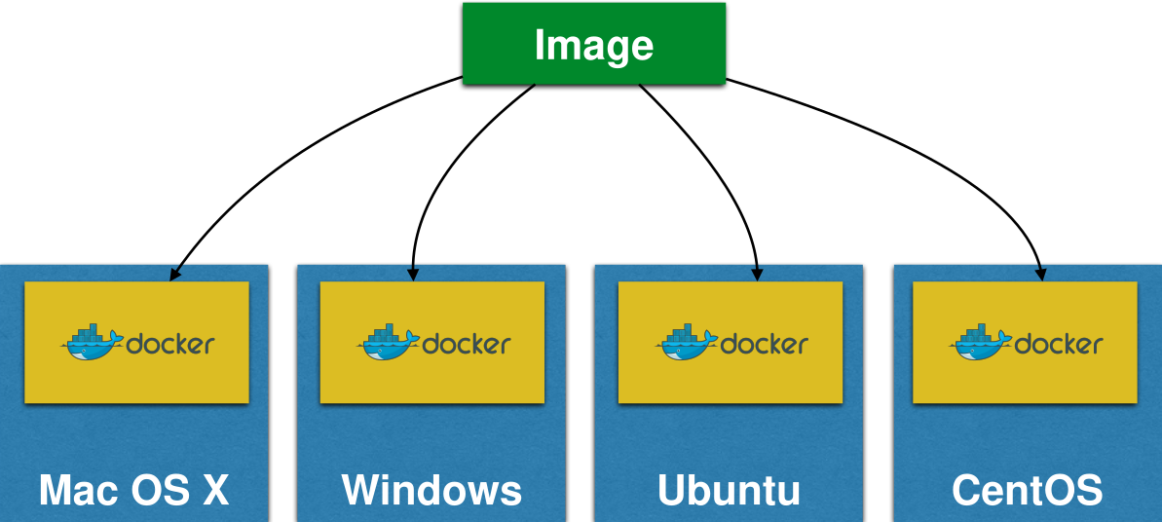
PODA - Package Once Deploy Anywhere

Slide 9
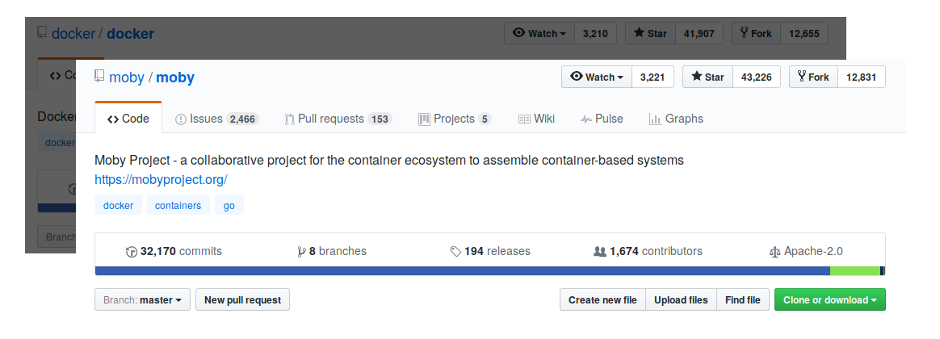
What is Docker?
Open source project and company
Used to create containers for software applications
Package Once Deploy Anywhere (PODA)

Slide 10
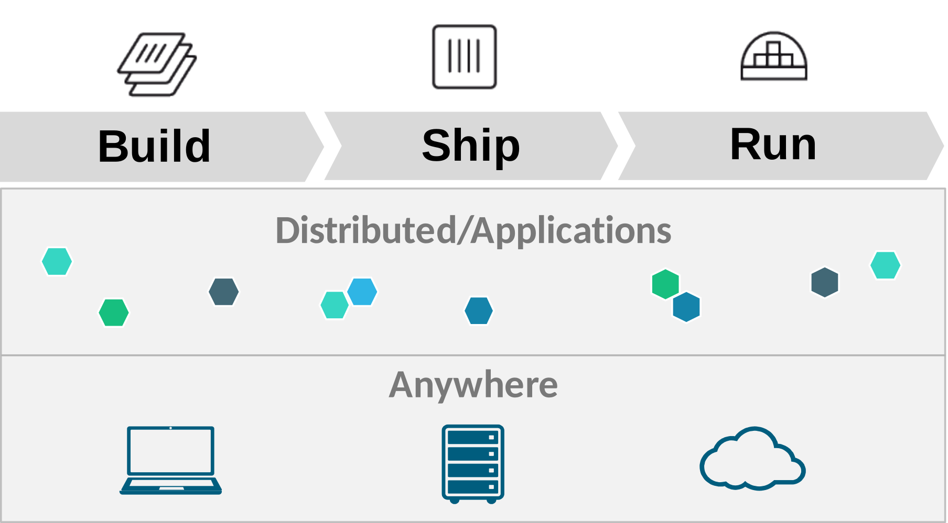
Docker Mission
Notes:
Build — develop an app using Docker containers with any language and any toolchain
Ship — ship the dockerized app and dependencies anywhere — to QA, teammates, or the cloud — without breaking anything
Run — scale to 1000s of nodes, move between data centers and clouds, update with zero downtime and more

Slide 11
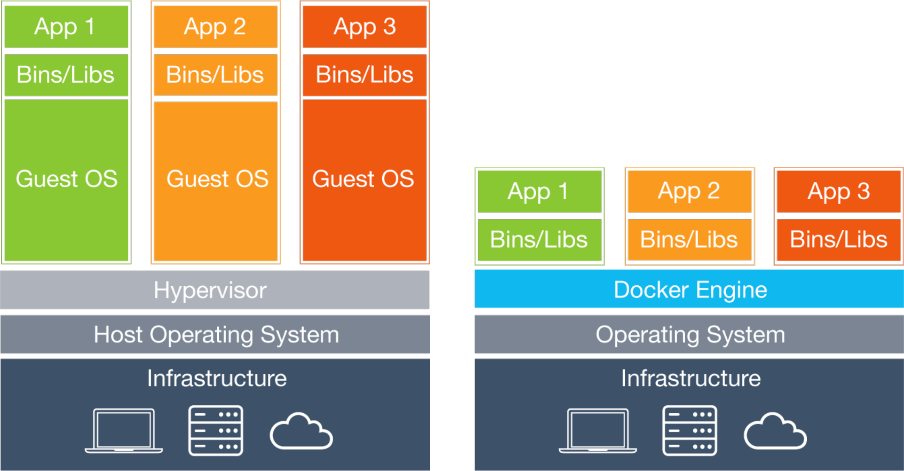
VMs vs Containers

Slide 12
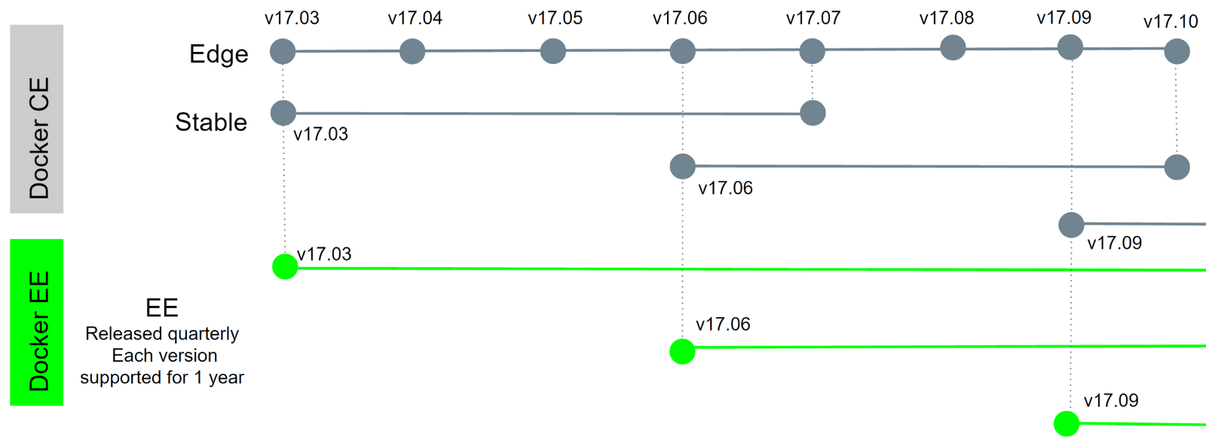
Install Docker
Available in 2 editions: Community Edition (CE) and Enterprise Edition (EE).
Docker for Mac/Windows (Desktop) and Linux (Server)
Time-based release schedule
CE: Monthly edge and quarterly stable release
EE: Released quarterly, each version supported for 1 year
https://docs.docker.com/install
Notes:
Time-based release schedule
Starting with Docker 17.03, Docker uses a time-based release schedule.
Docker CE Edge releases generally happen monthly.
Docker CE Stable releases generally happen quarterly, with patch releases as needed.
Docker EE releases generally happen twice per year, with patch releases as needed.
Updates, and patches
A given Docker EE release receives patches and updates for at least one year after it is released.
A given Docker CE Stable release receives patches and updates for one month after the next Docker CE Stable release.
A given Docker CE Edge release does not receive any patches or updates after a subsequent Docker CE Edge or Stable release.

Slide 13
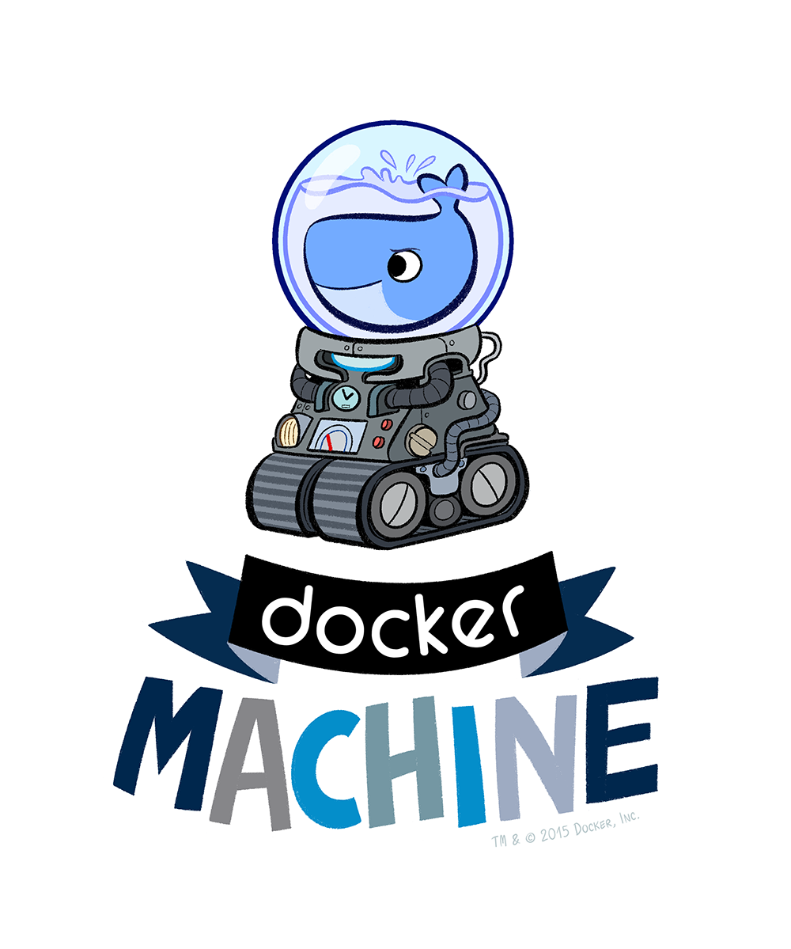
Docker Machine
Create Docker Host on computer or cloud provider docker-machine create --driver=virtualbox myhost
Configure Docker client to talk to host
Create and pull images
Start, stop, restart containers
Upgrade Docker
https://docs.docker.com/machine/overview/

Slide 14
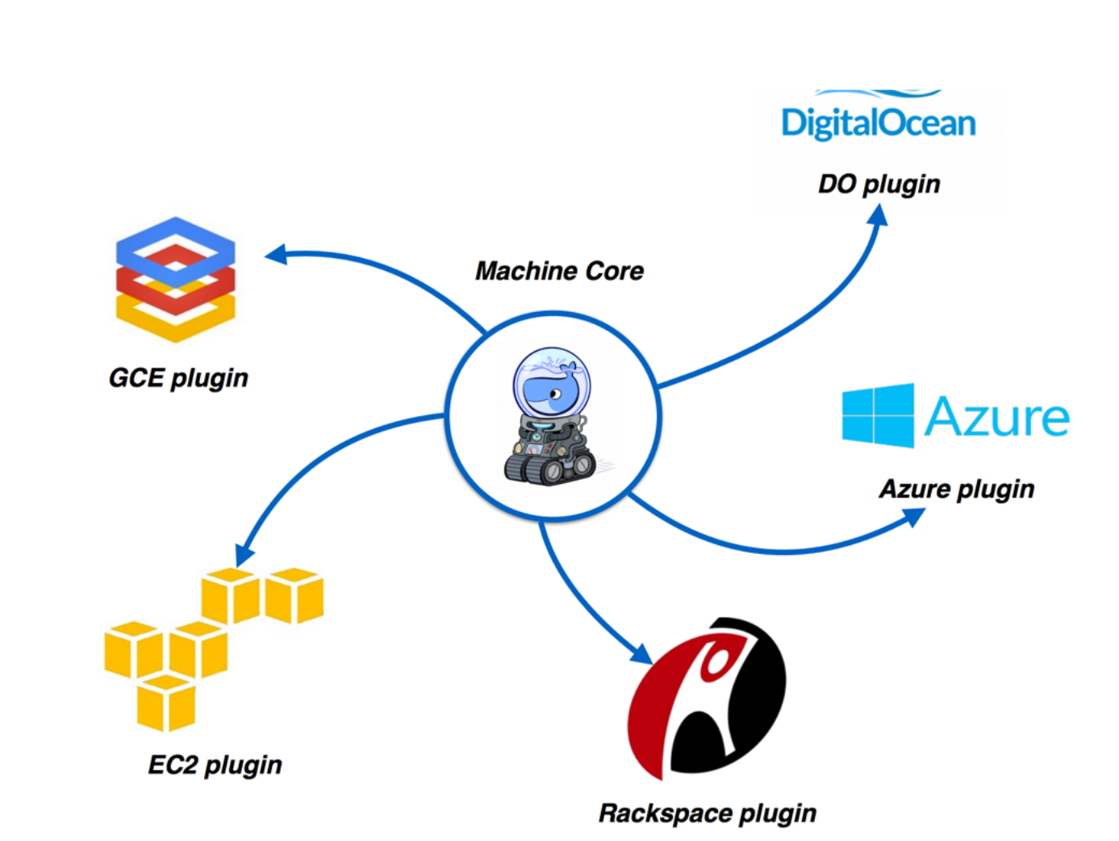
Docker Machine Providers

Slide 15

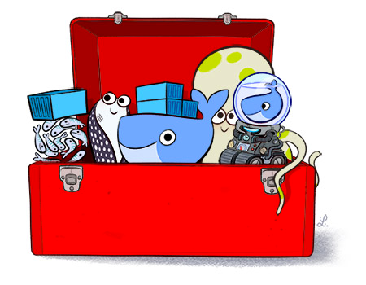
Docker Toolbox
Docker Client
Docker Machine
Docker Compose
Docker Kitematic
Boot2Docker ISO
Virtualbox
https://docs.docker.com/toolbox/overview/

Slide 16
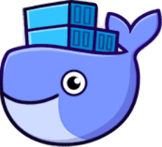
Docker for Mac/Windows
Native application and UI
Auto update capability
No additional software required, e.g. VirtualBox
OSX: xhyve VM using Hypervisor.framework
Windows: Hyper-V VM
Better networking and filesystem mounting/notification
Requires Yosemite 10.10+ or Windows 10 64-bit
https://docs.docker.com/docker-for-mac
https://docs.docker.com/docker-for-windows

Slide 17
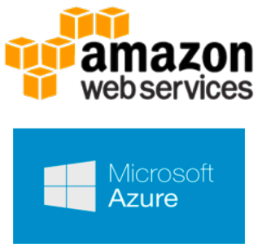
Docker for AWS/Azure
Amazon Web Services
Amazon CloudFormation templates
Integrated with Autoscaling, ELB, and EBS
Azure
Integrated with VM Scale Sets for autoscaling, Azure Load Balancer, Azure Storage
https://docs.docker.com/docker-for-aws/
https://docs.docker.com/docker-for-azure/

Slide 18
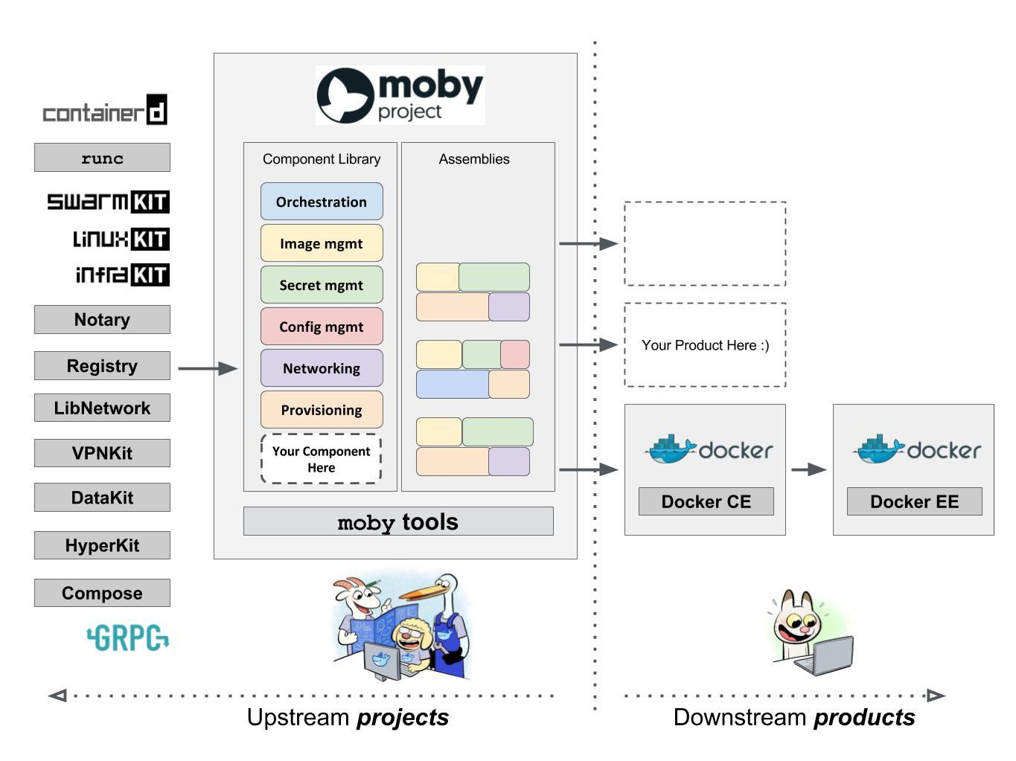
Meet the Moby
https://mobyproject.org/

Slide 19
Docker Workflow

Slide 20
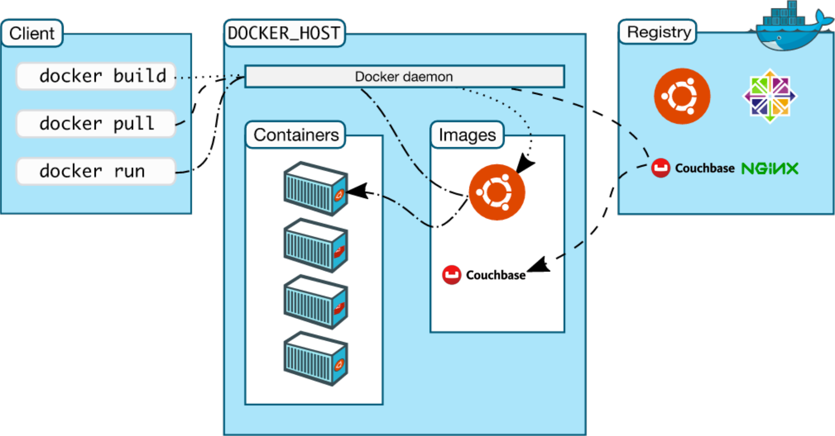
Docker Workflow

Slide 21
Build
Image defined in text-based Dockerfile
List of commands to build the image
Docker commands to build the image
FROM ubuntu
ENTRYPOINT ["echo", "Hello world!!!"]
docker build -t org/hello .

Slide 22
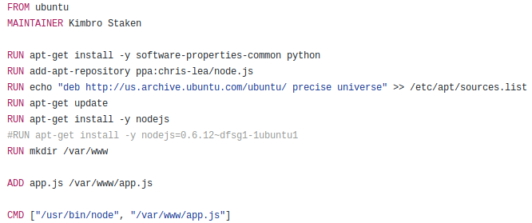
Dockerfile
https://docs.docker.com/engine/reference/builder/

Slide 23
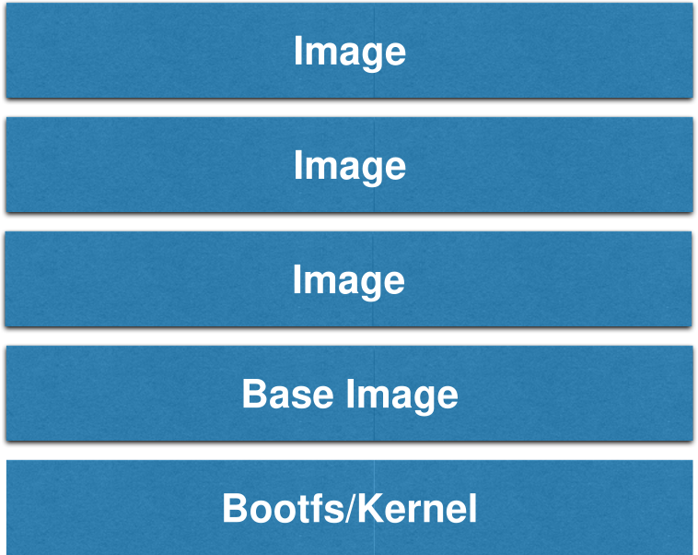
Union File System
openjdk:latest
build-deps:stretch-scm
build-deps:stretch-curl
debian:stretch

Slide 24
Image Layers - OpenJDK
$ docker images openjdk
REPOSITORY TAG IMAGE ID CREATED SIZE
openjdk latest 891c9734d5ab 5 weeks ago 726MB
$ docker history openjdk
IMAGE CREATED CREATED BY SIZE COMMENT
891c9734d5ab 5 weeks ago /bin/sh -c /var/lib/dpkg/info/ca-certificate… 394kB
<missing> 5 weeks ago /bin/sh -c set -ex; if [ ! -d /usr/share/m… 450MB
<missing> 5 weeks ago /bin/sh -c #(nop) ENV CA_CERTIFICATES_JAVA_… 0B
<missing> 5 weeks ago /bin/sh -c #(nop) ENV JAVA_DEBIAN_VERSION=8… 0B
<missing> 5 weeks ago /bin/sh -c #(nop) ENV JAVA_VERSION=8u162 0B
<missing> 5 weeks ago /bin/sh -c #(nop) ENV JAVA_HOME=/docker-jav… 0B
<missing> 5 weeks ago /bin/sh -c ln -svT "/usr/lib/jvm/java-8-open… 33B
<missing> 5 weeks ago /bin/sh -c { echo '#!/bin/sh'; echo 'set… 87B
<missing> 5 weeks ago /bin/sh -c #(nop) ENV LANG=C.UTF-8 0B
<missing> 5 weeks ago /bin/sh -c apt-get update && apt-get install… 2.21MB
<missing> 5 weeks ago /bin/sh -c apt-get update && apt-get install… 142MB
<missing> 5 weeks ago /bin/sh -c set -ex; if ! command -v gpg > /… 7.8MB
<missing> 5 weeks ago /bin/sh -c apt-get update && apt-get install… 23.8MB
<missing> 5 weeks ago /bin/sh -c #(nop) CMD ["bash"] 0B
<missing> 5 weeks ago /bin/sh -c #(nop) ADD file:b380df301ccb5ca09… 100MB

Slide 25
Ship
Store and distribute Docker images with Docker Registry
Control where images are stored
Own image distribution pipeline
Integrate image storage/distribution in dev workflow
Docker commands to push or pull the image
docker push org/hello
docker pull org/hello

Slide 26
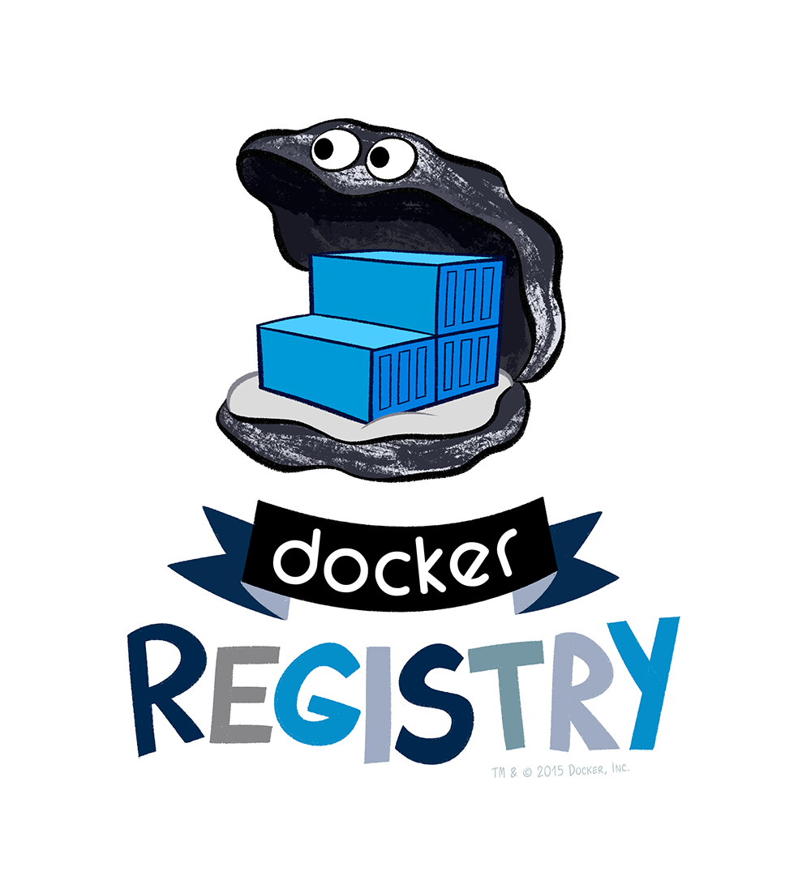
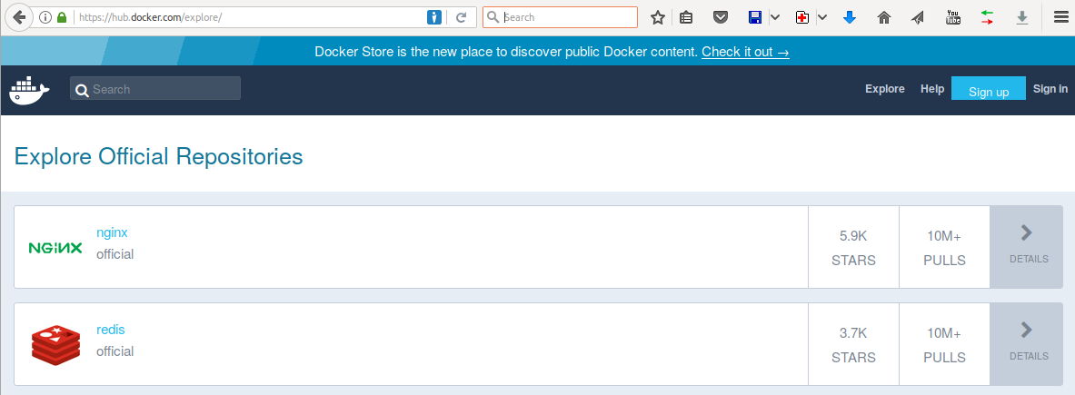
Docker registry
Docker Hub
Free-to-use and hosted
Docker Trusted Registry
Commercially supported
RBAC, LDAP/AD integration, updates, etc
Can be setup inside firewall
https://docs.docker.com/registry/
https://docs.docker.com/datacenter/dtr/2.3/guides/

Slide 27
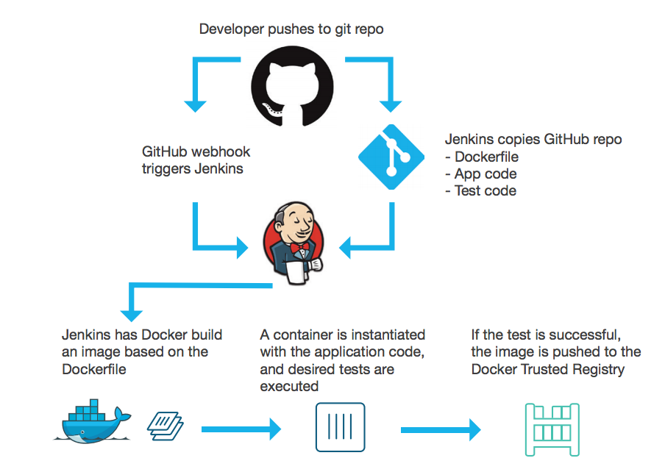
Registry primary usage
CI/CD with Docker
Centrally located base images
Store individual build images
Pull tested images to production

Slide 28
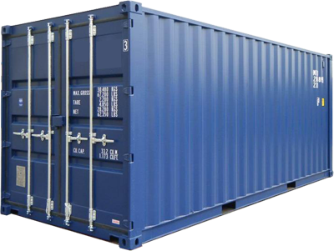
Run
Container built from the image
Runtime representation of the image
Self contained execution environment
docker run org/hello

Slide 29
Docker for Java developers

Slide 30
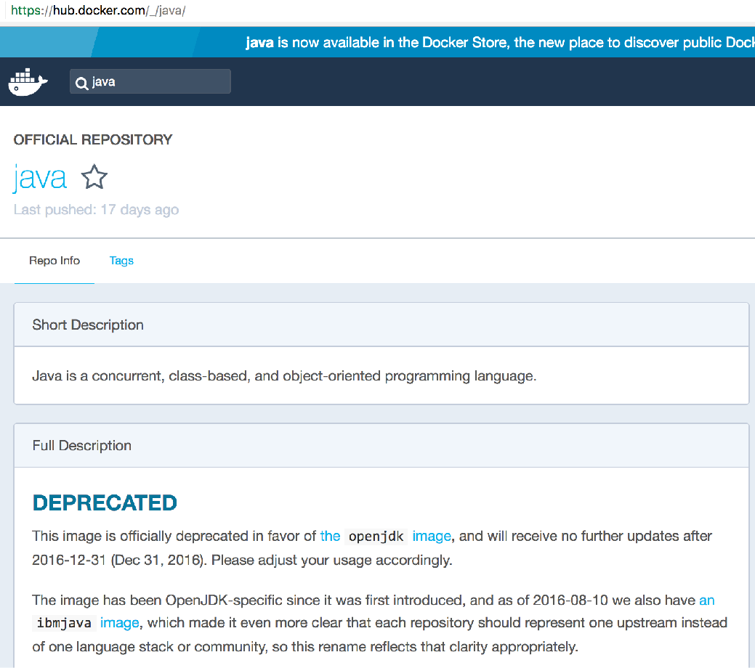
Java Base Image

Slide 31
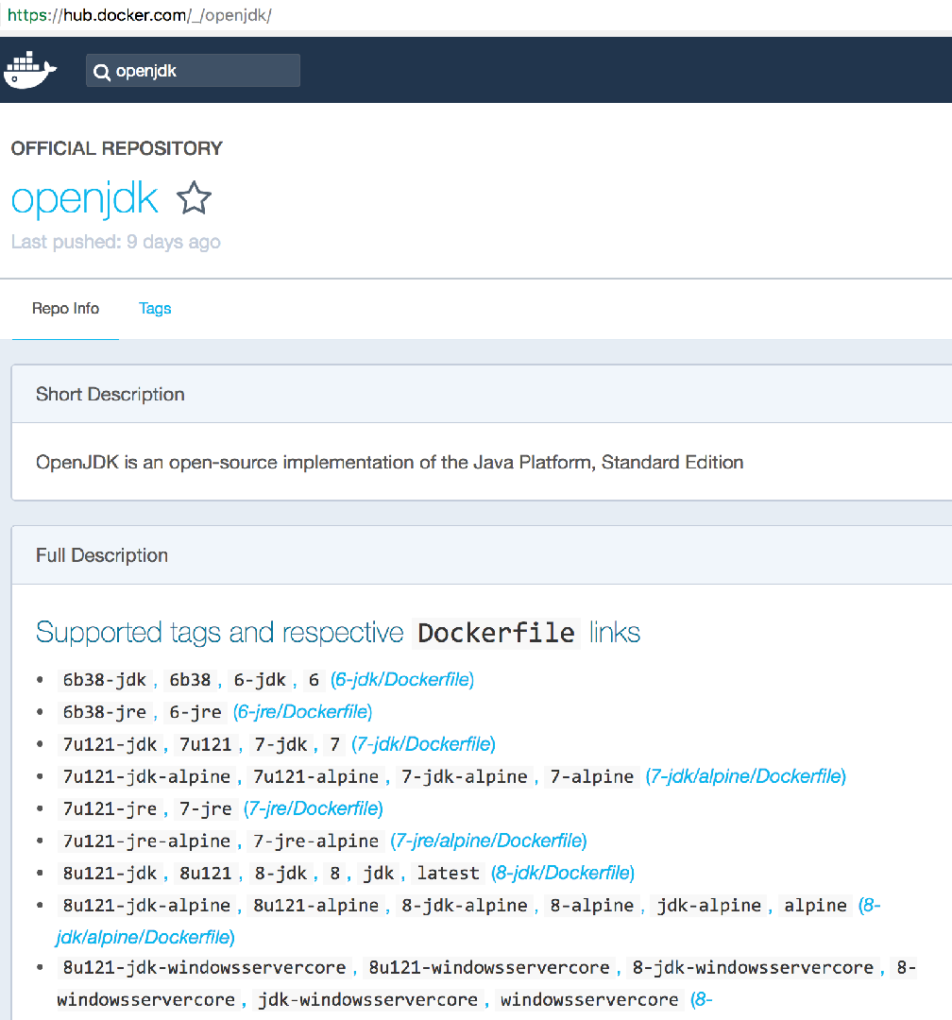
Java Base Image

Slide 32
First Java application
FROM openjdk:latest ADD target/hello.jar . EXPOSE 8080 ENTRYPOINT ["/usr/bin/java", "-jar", "hello.jar"]

Slide 33
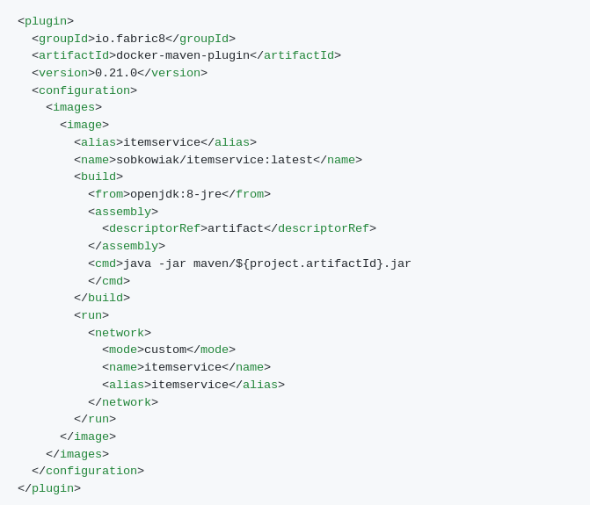
Maven Plugin
Plugin <groupId>io.fabric8</groupId> <artifactId>docker-maven-plugin</artifactId> <version>0.20.1</version>
Goals: docker:X, X= stop, build, push, ...
https://dmp.fabric8.io/

Slide 34

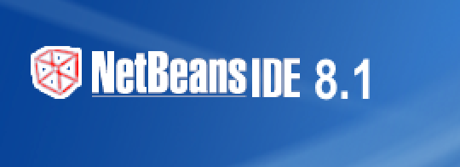

Docker Support in Java IDEs
https://github.com/arun-gupta/docker-java-ides

Slide 35
Running in debug mode
docker run -p5005:5005 \
-e JAVA_OPTIONS= \
‘-Xdebug -Xrunjdwp:transport=dt_socket,server=y,suspend=y,address=5005' \
hello-world

Slide 36
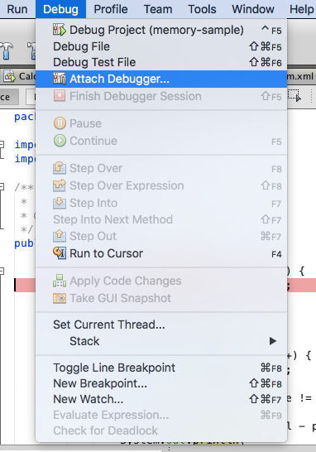
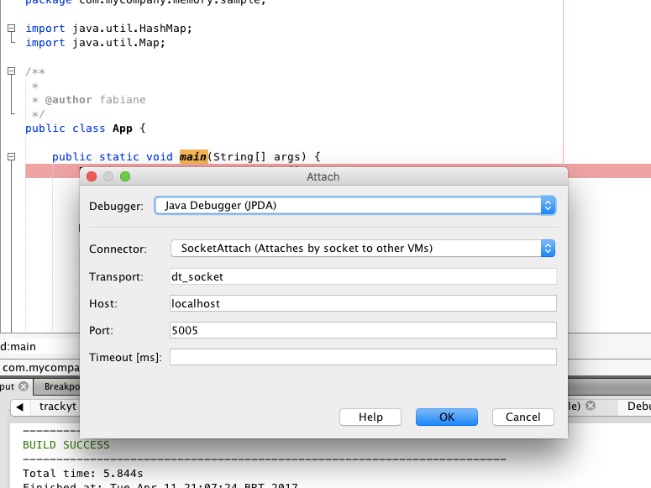
Attaching the IDE

Slide 37
Multi-Container Application

Slide 38
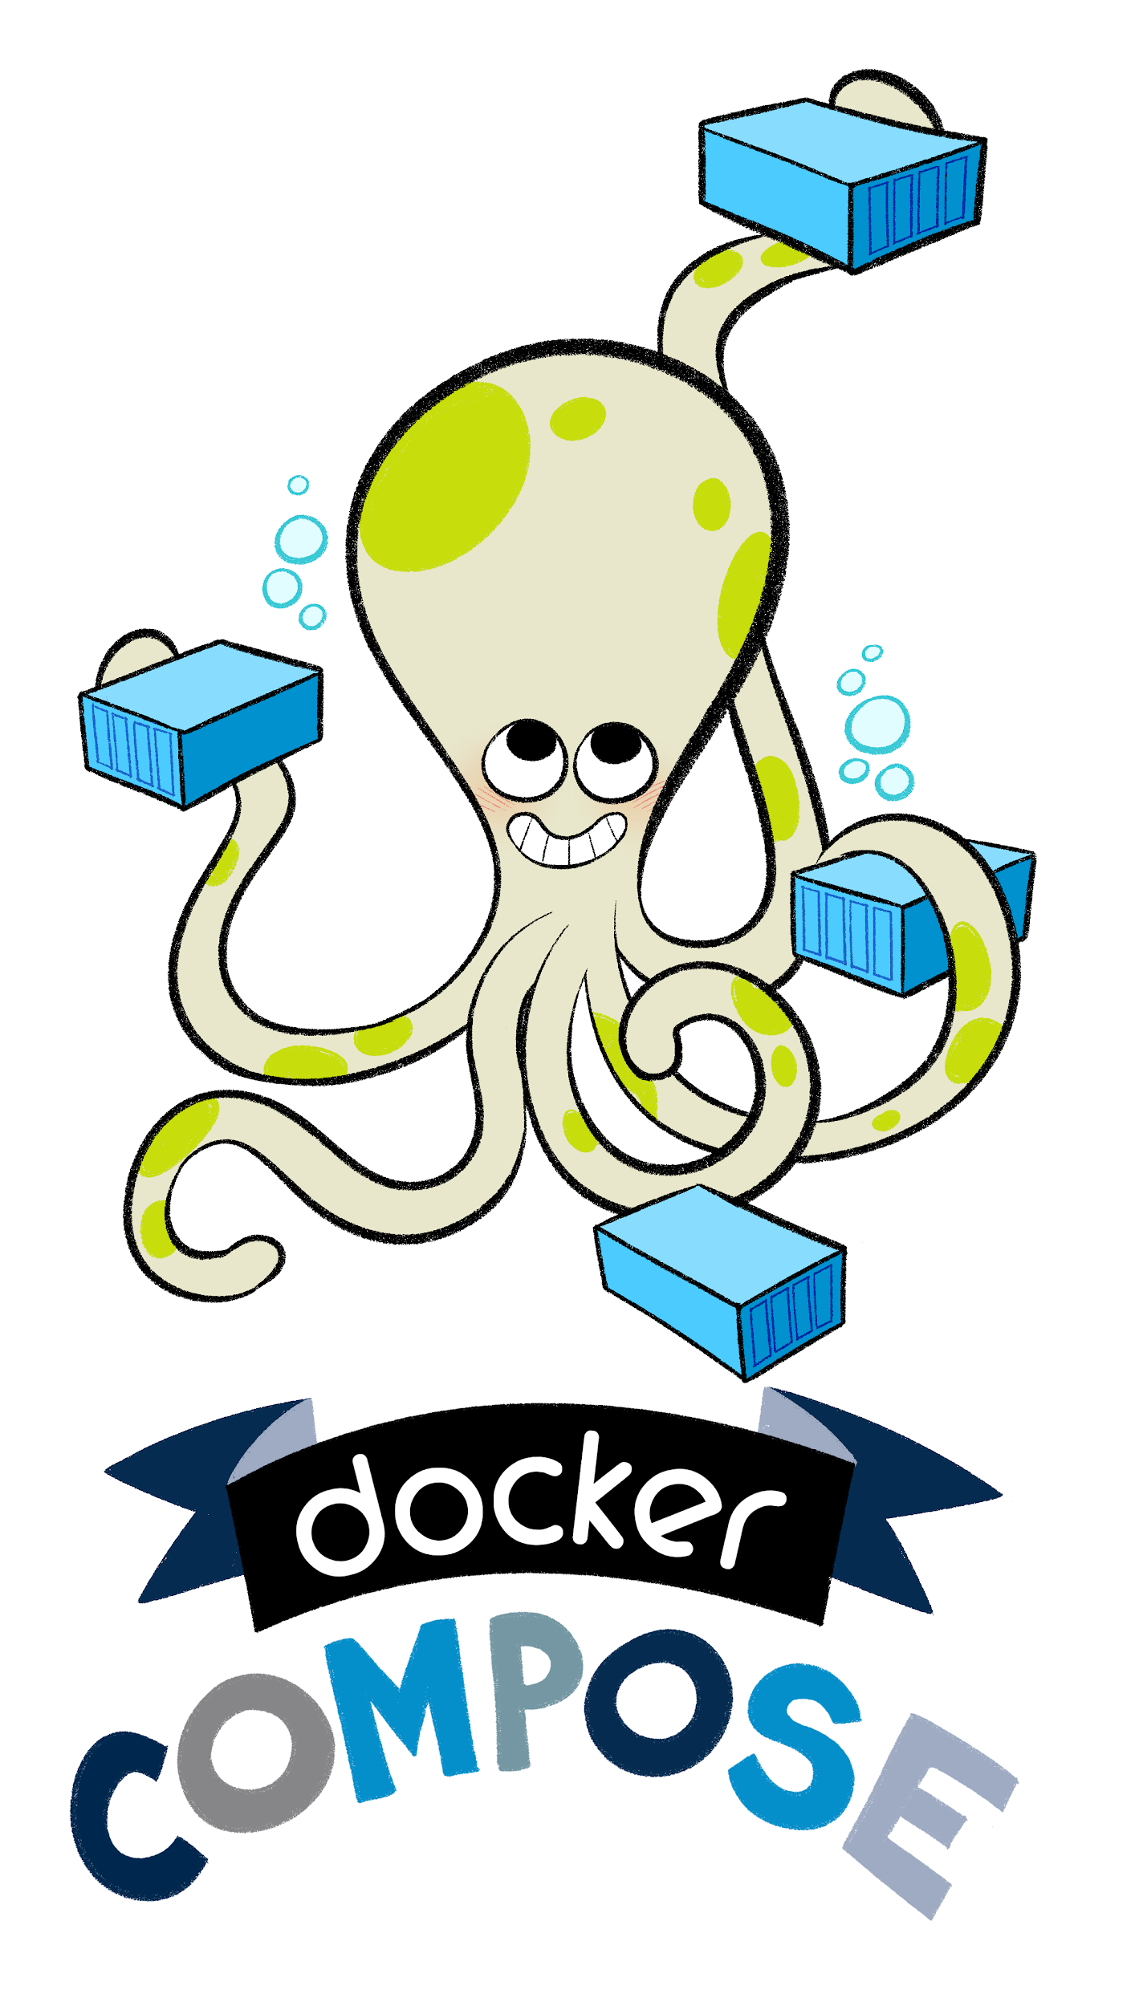
Docker Compose
Define and run multi-container applications
Configuration defined in one or more files
docker-compose.yml (default)
docker-compose.override.yml (default)
Multiple files specified using -f
Single command to manage all services
Great for dev, staging, and CI
https://docs.docker.com/compose/overview/

Slide 39
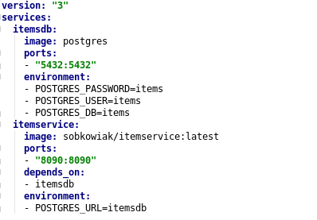
Multi-container on single host
docker-compose up -d

Slide 40
Multi-host using Swarm Mode

Slide 41
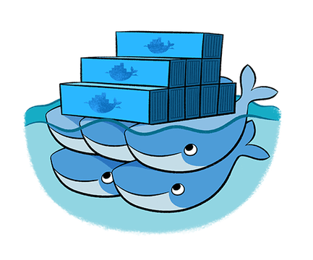
Swarm Mode
Natively managing a cluster of Docker Engines called a Swarm
Docker CLI to create a swarm, deploy apps, and manage swarm
Optional feature, need to be explicitly enabled
No Single Point of Failure (SPOF)
Declarative state model
Self-organizing, self-healing
Service discovery, load balancing and scaling
Rolling updates
https://docs.docker.com/engine/swarm/

Slide 42
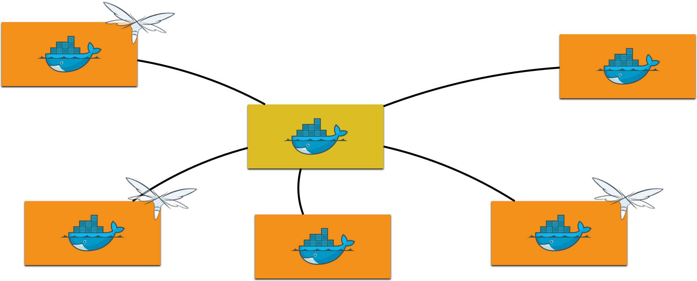
Swarm Mode - Replicated Service
docker service create --replicas 3 --name itemservice sobkowiak/itemservice

Slide 43
Multi-container on multiple hosts
docker stack deploy --compose-file=docker-compose.yml webapp

Slide 44
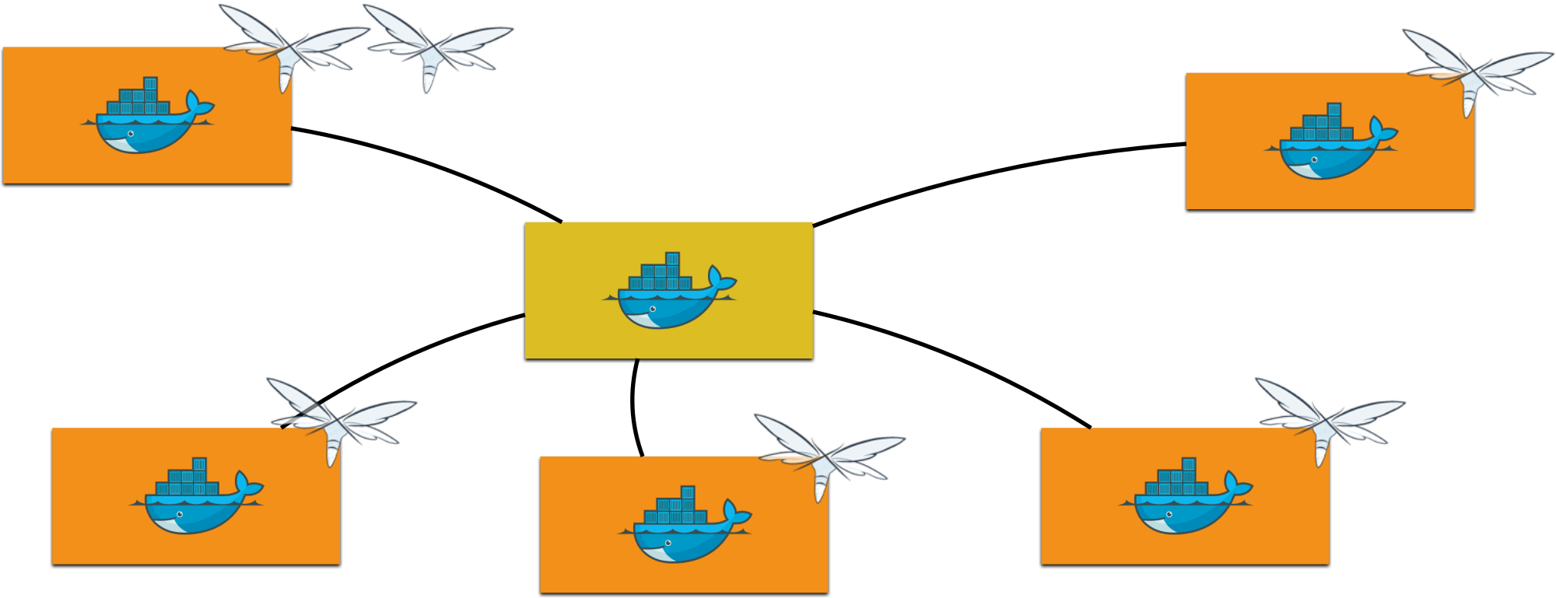
Swarm Mode - Replicated Service
docker service scale itemservice=6

Slide 45
Monitoring

Slide 46

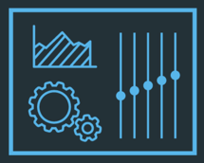



Monitoring Docker Containers
docker stats command
LogEntries
Service logs: docker service logs <service>
Prometheus endpoint - New in Docker 1.13
Docker Remote API: /container/{container-name|cid}/stats
Docker Universal Control Plane
cAdvisor
Prometheus
InfluxDB

Slide 47


Slide 48

What’s next?
Deep dive into Docker
Advanced Swarm Mode
Kubernetes
Microservices in Practice (Deploy Spring Boot & Spring Cloud based microservices on Docker) - WKS 14.09.18, WRO 22-23.10.18
...

Slide 49
References
Slides: https://github.com/ksobkowiak-talks/capgemini-craftsmanship-community-20180427/tree/master/slides
Demo: https://github.com/ksobkowiak-talks/capgemini-craftsmanship-community-20180427/tree/master/demos

Slide 50
Credits
Special thanks to all the people who made and released their awesome resources for free:
Docker for Java Developers by Fabiane Nardon and Arun Gupta
Docker for Java Developers by Arun Gupta

